Slide 1
Introduction to R language Data Types and Basic Operation

Slide 2
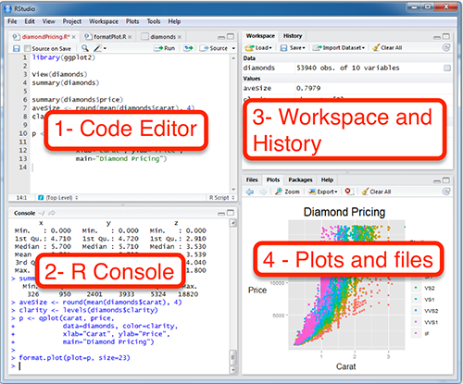
Install R and RStudio
R is free and powerful statistical software for analyzing and visualizing data. R and RStudio can be installed on Windows, MAC OSX and Linux platforms. RStudio is an integrated development environment for R that makes using R easier. It includes a console, code editor and tools for plotting.

Slide 3
Install R and RStudio
R can be downloaded and installed from the Comprehensive R Archive Network (CRAN)
webpage (http://cran.r-project.org/)
After installing R software, install also the Rstudio software available at
http://www.rstudio.com/Products/RStudio/.
Launch Rstudio and start use R inside R studio.

Slide 4
Install and load required R packages
An R package is a collection of functionalities that extends the capabilities of base R.
For this class, you should install the following packages:
tidyverse packages, which are a collection of R packages that share the same programing
philosophy. These packages include:
-readr: for importing data into R
-dplyr: for data manipulation
-ggplot2: for data visualization
ggpur package, which makes it easy, for beginner, to create publication ready plots.
Install:
install.packages(“tidyverse”)
install.packages(“ggpubr”)
library(“ggplot2”)
library(“ggpubr”)

Slide 5
Import your data in R
First, save your data into txt or csv formats and import it as follows:
library(“readr”)
#Reads tab delimited files (.txt tab)
my_data<-read_tsv(file.choose())
#Reads comma (,) delimited files (.csv)
my_data <-read_csv(file.choose())
#Reads semicolon (;) separated files (.csv)
my_data<otead_csv2(file.choose())

Slide 6
Demo data sets
data(“iris”) # Loading
Head(iris, n=3) # Print the first n=3 rows
To learn more about iris data sets, type this:
?iris

Slide 7
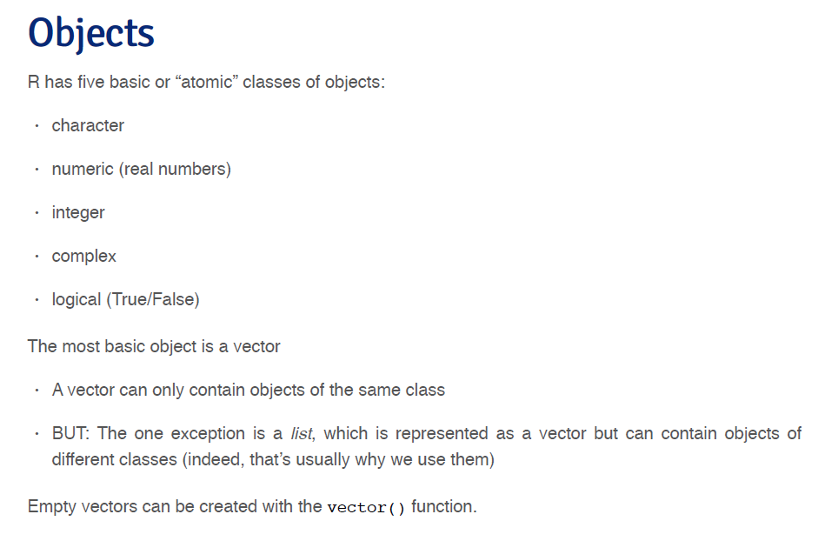

Slide 8
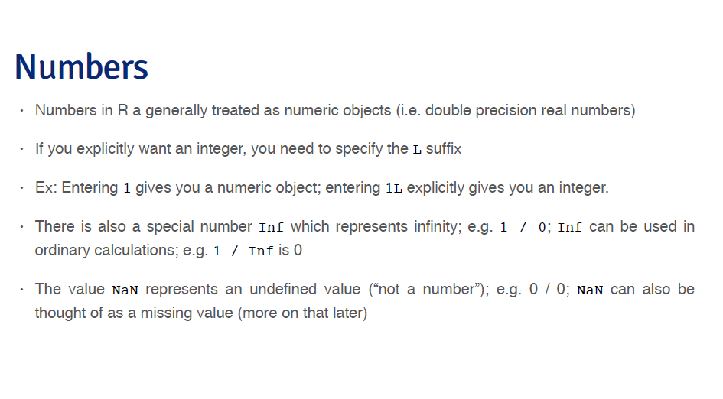

Slide 9
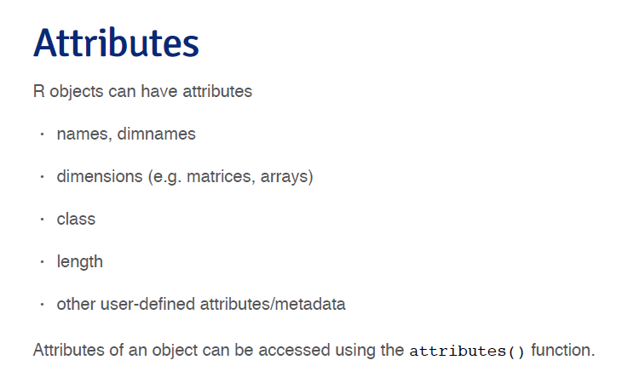

Slide 10
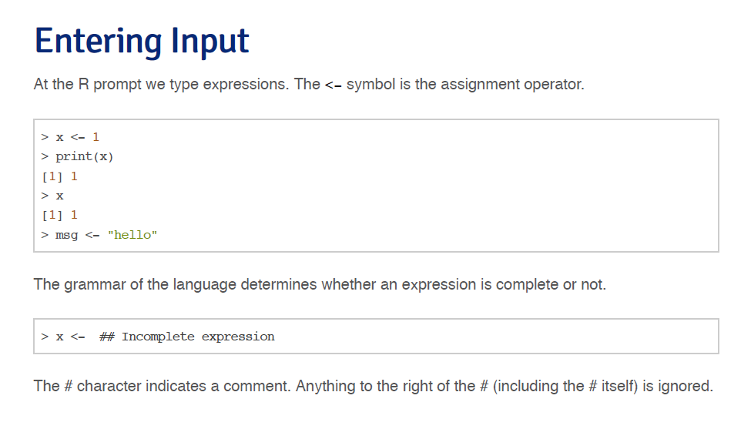

Slide 11
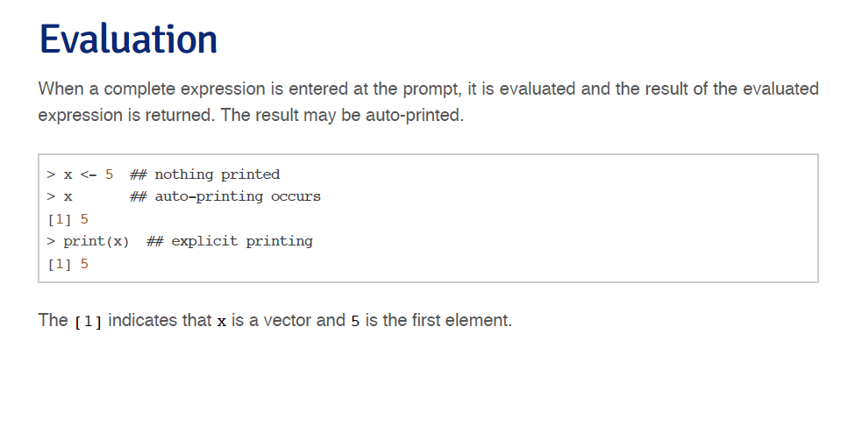

Slide 12
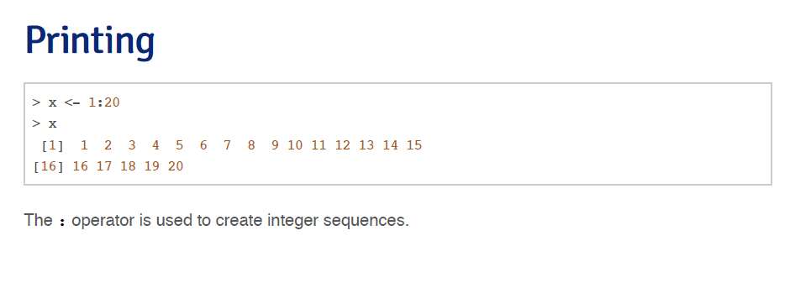

Slide 13
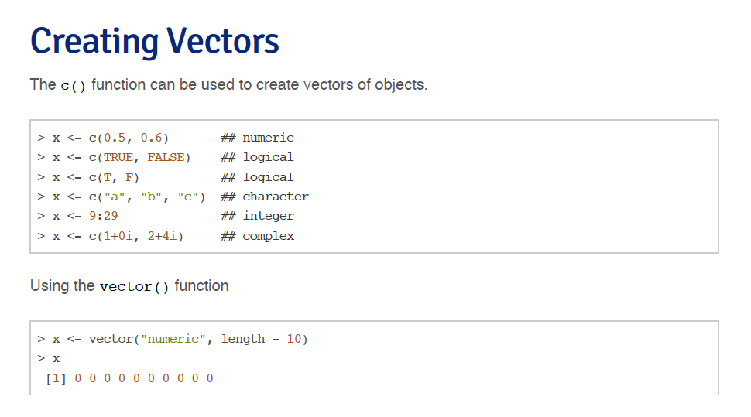

Slide 14


Slide 15
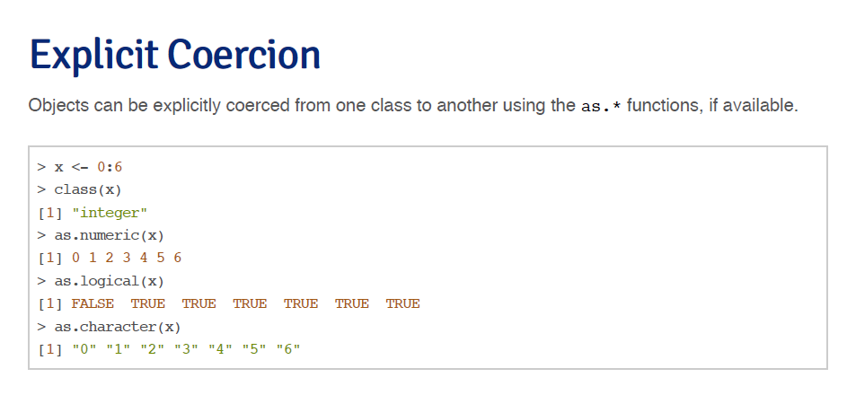

Slide 16


Slide 17


Slide 18
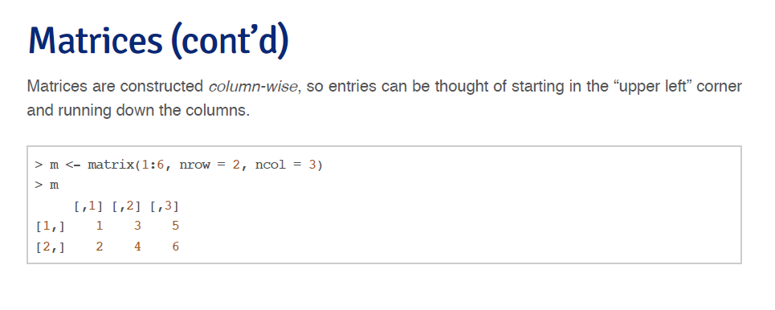

Slide 19


Slide 20
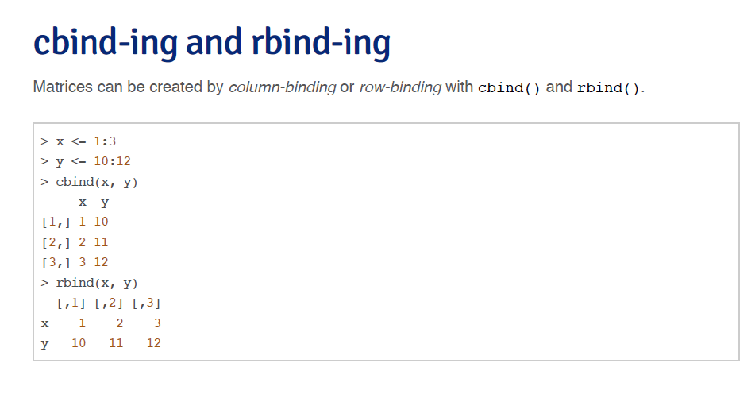

Slide 21


Slide 22
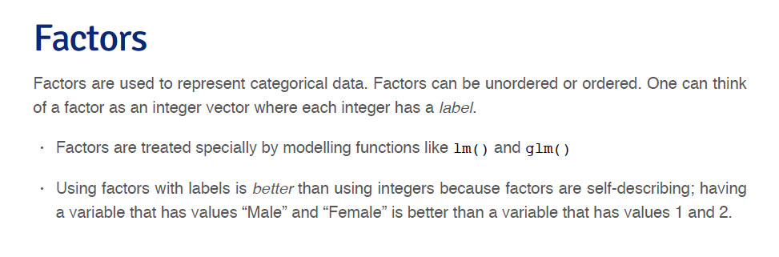

Slide 23


Slide 24


Slide 25


Slide 26


Slide 27
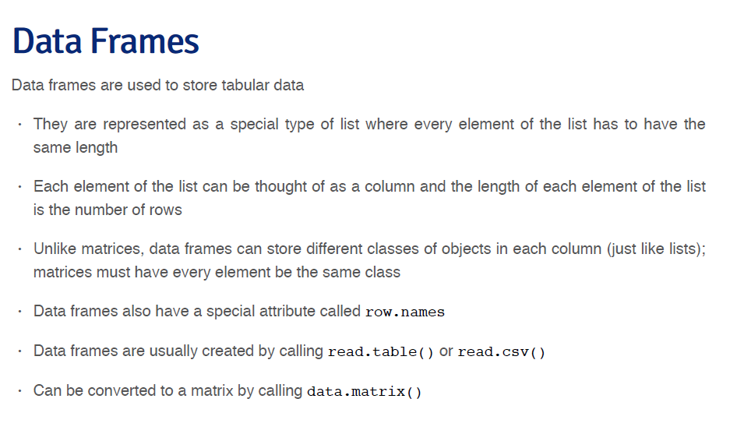

Slide 28


Slide 29


Slide 30


Slide 31


Slide 32


Slide 33
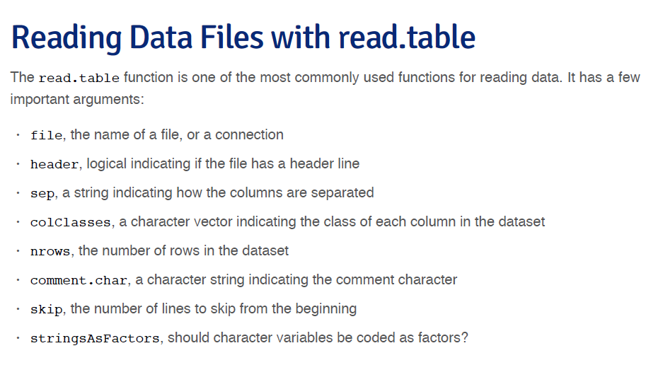

Slide 34
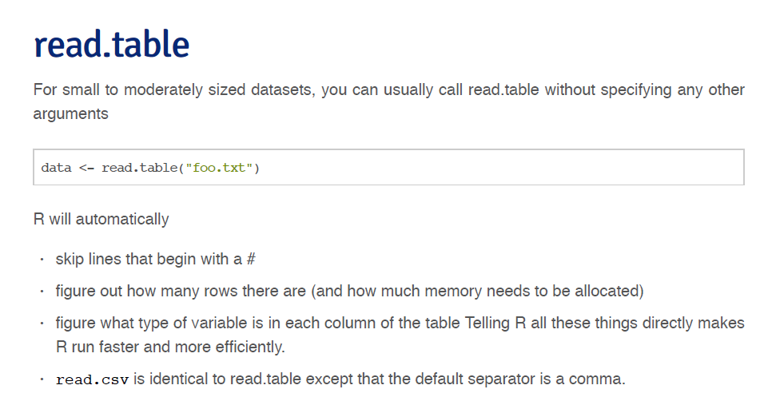

Slide 35
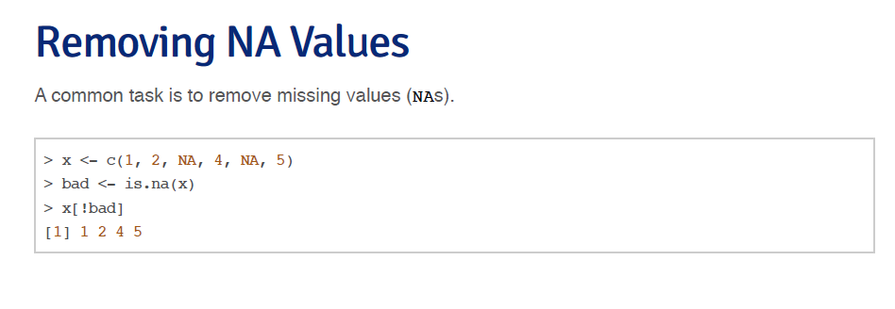

Slide 36


Slide 37


